Slide 1

COVID 19 Engine
A Web Application with some Machine Learning Implementation

Slide 2

What’s The Idea?

Slide 3
We made a website which will solve some basic problems of current global pandemic Coronavirus
Users will get a ALL-IN-ONE web app to see some important results
Results ? What type of results ?
Most Importantly we will give a Notification System which will notify the users after some time , say 1 hour
Implementation of ML is used to determine the probability rate of having Coronavirus

Slide 4
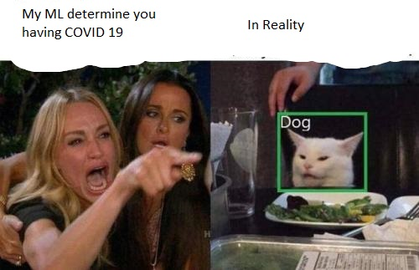
ML for determining Coronavirus?

Slide 5
What Tech Stack we used?
Frontend – HTML5,CSS3,BOOTSTRAP4
Backend – Python with Flask
JavaScript
Python for Notification System
Machine Learning – Scikit Learn, Pandas, NumPy, PlotLy, Random Forest Classifier

Slide 6
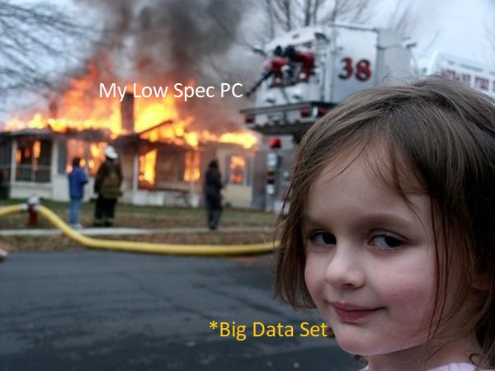
Problem of Data Set-

Slide 7
THANK YOU
QUESTIONS?

